Slide 1


Jacob Carr
2025-08-22

Slide 2

Outline
Executive Summary
Introduction
Methodology
Results
Conclusion
Appendix

Slide 3
Executive Summary
Summary of methodologies
Data collection with Web Scraping
Data wrangling
Exploratory Data using SQL
Exploratory Data Analysis for Visualization
Interactive Visual Analytics with Folium
Interactive Visual Analytics with Plotly Dash
Machine Learning Predictive Analysis for Classification
Summary of all results
Exploratory Data Analysis Results
Interactive Analytics
Predictive Analysis Results

Slide 4
Introduction
Project background and context
In this capstone project, we seek to understand the factors affecting the successful landing of SpaceX Falcon 9 rocket launches. The cost of each launch is above 60 million dollars, but the reusability of the first stage nonetheless provides a significant cost savings compared to alternatives. As such, it is desirable to have a model that provides accurate prediction of whether a launch will be successful. This information can be used to improve launch design and to increase the likelihood of successful launches in the future.
Problems you want to find answers
For a given set of features of Falcon 9 rocket launches, including payload mass, orbit type, launch site, etc., will the first stage of the rocket land successfully?

Slide 5

Section 1

Slide 6
Methodology
Executive Summary
Data collection methodology:
Data was collected through web scraping and using the SpaceX API
Perform data wrangling
Data filtering was performed, missing values were replaced with mean values for certain variables, and One Hot encoding was used to prepare data for binary classification
Perform exploratory data analysis (EDA) using visualization and SQL
Perform interactive visual analytics using Folium and Plotly Dash
Perform predictive analysis using classification models
Models were built, trained, and tuned using a variety of methods, including Logistic Regression, Support Vector Machines, Decision Trees, and K-Nearest Neighbors

Slide 7
Data Collection
Data were collected through web scraping and using the SpaceX API
SpaceX API Data Collection
Data on SpaceX launches can be accessed through the API here: https://api.spacexdata.com/v4/launches/past
For more consistent results in this capstone project, data was collected using JSON results from this static URL: https://cf-courses-data.s3.us.cloud-object-storage.appdomain.cloud/IBM-DS0321EN-SkillsNetwork/datasets/API_call_spacex_api.json
Web Scraping Data Collection
Data on SpaceX launches was also collected using web scraping from the static Wikipedia page here: https://en.wikipedia.org/w/index.php?title=List_of_Falcon_9_and_Falcon_Heavy_launches&oldid=1027686922

Slide 8
Data Collection – SpaceX API
REST calls from the SpaceX API was used to collect data including Flight Number, Date, Booster Version, Payload Mass, Orbit Type, Launch Site, Outcome, etc.
The notebook for this section can be found here: https://github.com/JCarr412/Coursera-DataScience/blob/main/1_jupyter-labs-spacex-data-collection-api.ipynb
Request launch data from the SpaceX API
Apply purpose-built functions to fill in certain dataframe fields
Replace missing values for Payload Mass with the calculated mean
Create dataframe from the JSON results
Filter data to only include Falcon 9 launches
Export data to a CSV for future use

Slide 9
Data Collection - Scraping
Web scraping was performed using the Wikipedia page on SpaceX launches to obtain data including Flight Number, Launch Site, Payload, Payload Mass, etc.
The notebook for this section can be found here: https://github.com/JCarr412/Coursera-DataScience/blob/main/2_jupyter-labs-webscraping.ipynb
Request launch data from Wikipedia page
Extract column names from the HTML Headers
Create a dataframe from the dictionary
Create BeautifulSoup object from the HTML response
Parse collected data and construct a dictionary
Export data to a CSV for future use

Slide 10
Data Wrangling
Data wrangling was completed through the following tasks:
Calculating the number of launches on each site
Calculating the number and occurrence of each orbit
Calculating the number and occurrence of mission outcome of the orbits
Creating a landing outcome label from the Outcome column
Exporting the processed data to a CSV
The completed notebook for this section can be found here: https://github.com/JCarr412/Coursera-DataScience/blob/main/3_labs-jupyter-spacex-Data%20wrangling.ipynb

Slide 11
EDA with Data Visualization
Exploratory data analysis was performed, and plots, including scatter plots, bar charts, and line plots were created to explore relationships between flight number, payload mass, launch site, orbit type, year, and success rate.
Example plots are shown on the following slides.
The completed notebook for this section can be found here: https://github.com/JCarr412/Coursera-DataScience/blob/main/5_edadataviz.ipynb

Slide 12
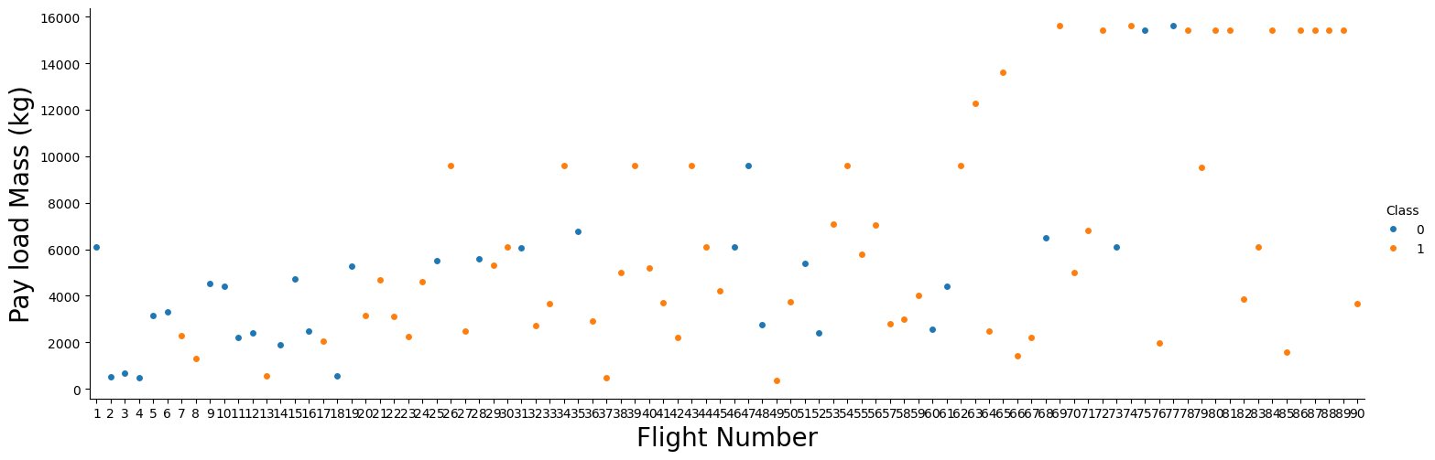
EDA with Data Visualization

Slide 13
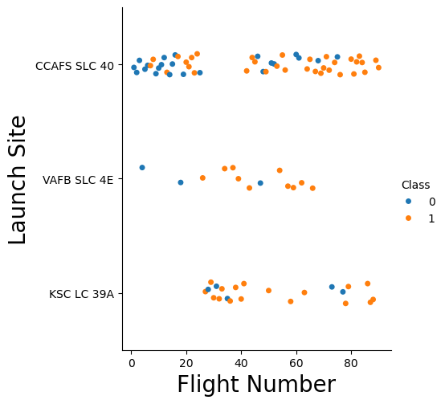
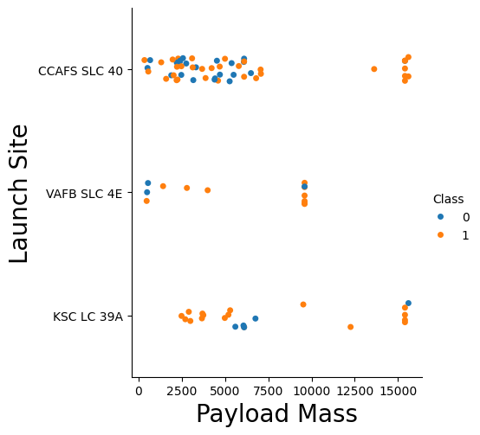
EDA with Data Visualization

Slide 14
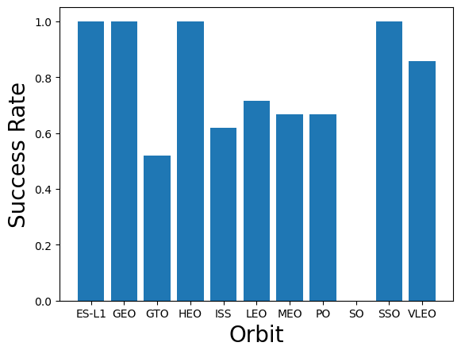
EDA with Data Visualization

Slide 15
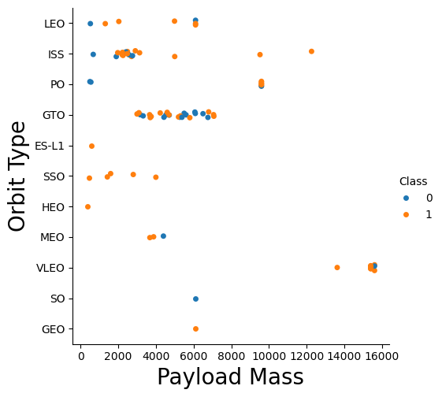
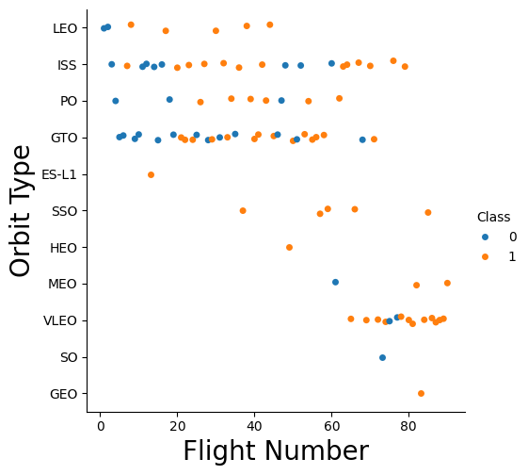
EDA with Data Visualization

Slide 16
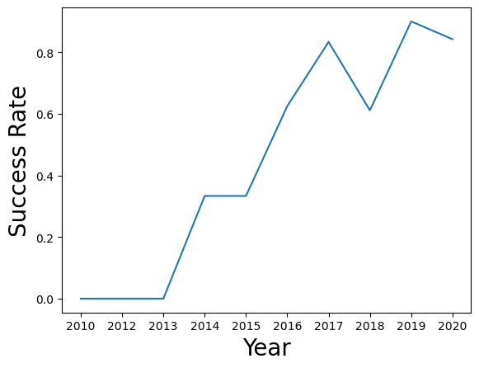
EDA with Data Visualization

Slide 17
EDA with SQL
SQL queries were performed for the following purposes:
Display the names of the unique launch sites in the space mission
Display 5 records where launch sites begin with the string 'CCA'
Display the total payload mass carried by boosters launched by NASA (CRS)
Display average payload mass carried by booster version F9 v1.1
List the date when the first successful landing outcome in ground pad was achieved
List the names of the boosters which have success in drone ship and have payload mass greater than 4000 but less than 6000
List the total number of successful and failure mission outcomes
List all the booster_versions that have carried the maximum payload mass, using a subquery with a suitable aggregate function
List the records which will display the month names, failure landing_outcomes in drone ship ,booster versions, launch_site for the months in year 2015
Rank the count of landing outcomes (such as Failure (drone ship) or Success (ground pad)) between the date 2010-06-04 and 2017-03-20, in descending order
The completed notebook for this section can be found here: https://github.com/JCarr412/Coursera-DataScience/blob/main/4_jupyter-labs-eda-sql-coursera_sqllite.ipynb

Slide 18
Build an Interactive Map with Folium
An interactive folium map was created to show:
A circle marker at each launch site for the successful and failed launches
A polyline showing the distance to the nearest coastline
The completed notebook for this section can be found here: https://github.com/JCarr412/Coursera-DataScience/blob/main/6_lab_jupyter_launch_site_location.ipynb

Slide 19
Build a Dashboard with Plotly Dash
An interactive dashboard was created to show the following:
A pie chart of total successful launches by site
Selectable pie charts for successful launched from each site
A plot of payload mass vs.outcome for all sites with color coding by booster version
A plot of payload mass vs.outcome for a selected site with color coding by booster version
Screenshots of the dashboard are shown on the following slides
The completed code for the plotly dash dashboard can be found here: https://github.com/JCarr412/Coursera-DataScience/blob/main/7_spacex-dash-app.py

Slide 20
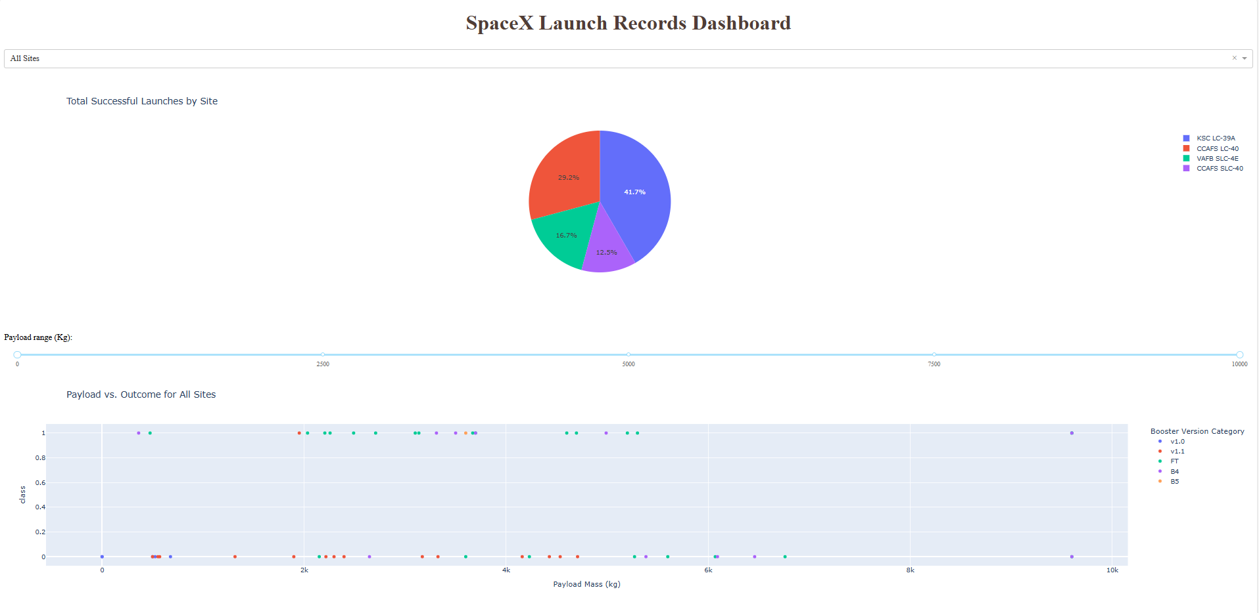
Build a Dashboard with Plotly Dash

Slide 21
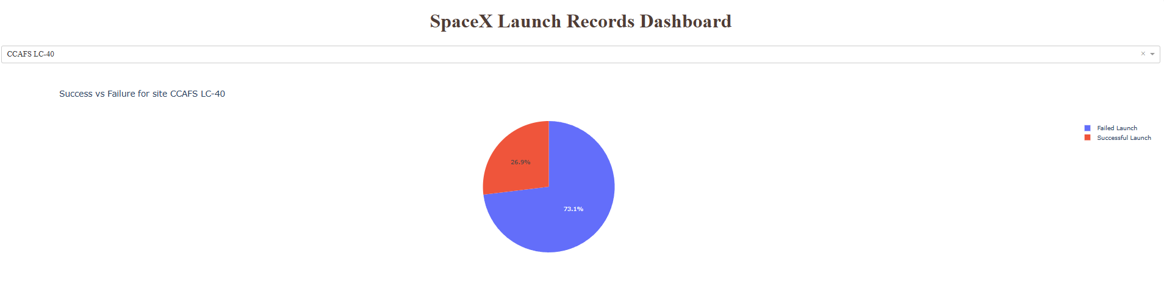
Build a Dashboard with Plotly Dash

Slide 22
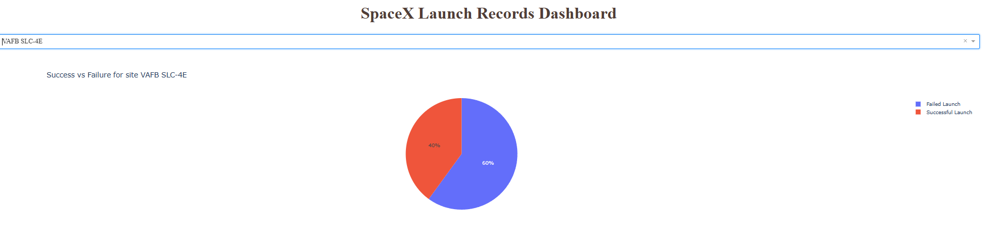
Build a Dashboard with Plotly Dash

Slide 23
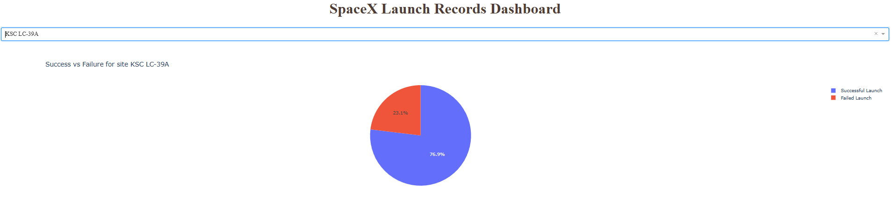
Build a Dashboard with Plotly Dash

Slide 24
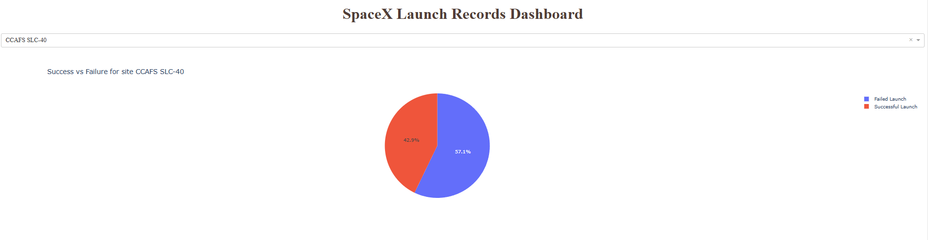
Build a Dashboard with Plotly Dash

Slide 25
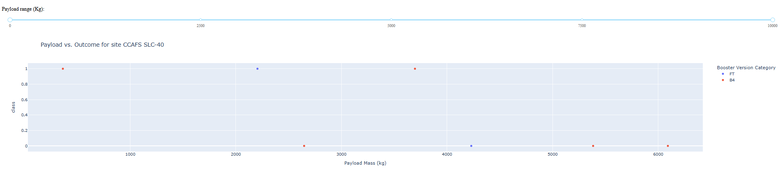
Build a Dashboard with Plotly Dash

Slide 26
Predictive Analysis (Classification)
Models were developed using the following methods:
Logistic Regression
Support Vector Machine
Decision Tree
K-Nearest Neighbors
For each model, tuned parameters were determined, and the model was evaluated using a confusion matrix and the method score
The completed notebook for this section can be found here: https://github.com/JCarr412/Coursera-DataScience/blob/main/8_completed_SpaceX_Machine%20Learning%20Prediction_Part_5.ipynb

Slide 27
Results
Exploratory data analysis results
Interactive analytics demo in screenshots
Predictive analysis results

Slide 28

Section 2

Slide 29
Flight Number vs. Launch Site
The plot shows increasing success rates with the later flights.
The plot shows that more launches occurred at the CCAFS SLC 40 site than at either of the other two sites
The plot does not show a clear trend in where launches occur as a function of flight number

Slide 30
Payload vs. Launch Site
The plot shows the range of payload masses that were handled at each launch site
The highest payload masses appear to have greater success rates
The highest payload masses were only launched from the CCAFS SLC 40 and KSC LC 39A sites

Slide 31
Success Rate vs. Orbit Type
Several orbit types have 100% success rates:
ES-L1, GEO, HEO, and SSO
One orbit type has a 0% success rate
SO
The success rate for other sites ranges from about 50% to about 85%

Slide 32
Flight Number vs. Orbit Type
The chart shows a trend in changes over time with the types of orbits that are being launched.
LEO, ISS, PO, GTO, and ES-L1 launches have been conducted since fairly early.
More recently, SSO, HEO, MEO, VLEO, SO, and GEO launches have been conducted.
Success rates for each type of launch can also be visualized on the plot

Slide 33
Payload vs. Orbit Type
The orbit type as a function of payload mass is shown on the plot.
The heaviest payloads are handled only by the VLEO orbit type.
The success rate as a function of orbit type and payload mass can also be seen

Slide 34
Launch Success Yearly Trend
The plot shows a fairly steady increase in success rate
Success rate in the early years was 0%
Success in the most recent years was above 80%

Slide 35
All Launch Site Names
Unique launch site names were found with the following query: %sql SELECT DISTINCT Launch_Site FROM SPACEXTBL
Results:
Launch_Site
CCAFS LC-40
VAFB SLC-4E
KSC LC-39A
CCAFS SLC-40

Slide 36
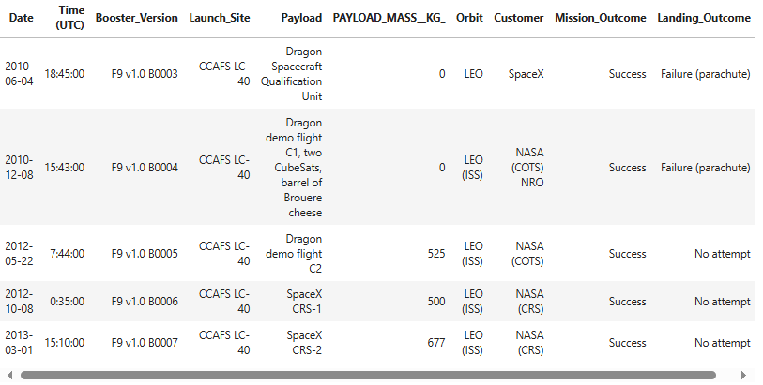
Launch Site Names Begin with 'CCA'
The sites beginning with CCA were found with this query: %sql SELECT * FROM SPACEXTBL WHERE Launch_Site LIKE 'CCA%' LIMIT 5;
Result:

Slide 37
Total Payload Mass
Total payload mass was found with this query: %sql SELECT SUM(PAYLOAD_MASS__KG_) AS Total_Payload_Mass FROM SPACEXTBL WHERE Customer = 'NASA (CRS)';
Result: 45596

Slide 38
Average Payload Mass by F9 v1.1
Average payload mass carried by booster version F9 V1.1 was found with this query: %sql SELECT AVG(PAYLOAD_MASS__KG_) AS Avg_Payload_Mass FROM SPACEXTBL WHERE Booster_Version = 'F9 v1.1';
Result: 2928.4

Slide 39
First Successful Ground Landing Date
The date of the first successful landing outcome on ground pad was found with this query: %sql SELECT MIN(Date) AS First_Successful_Ground_Pad_Landing FROM SPACEXTBL WHERE Landing_Outcome = 'Success (ground pad)';
Result: 2015-12-22

Slide 40
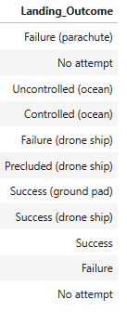
Successful Drone Ship Landing with Payload between 4000 and 6000
The names of boosters which have successfully landed on drone ship and had payload mass greater than 4000 but less than 6000 were found with this query: %sql SELECT DISTINCT Landing_Outcome FROM SPACEXTBL
Result shown to the right

Slide 41
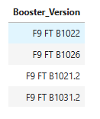
Total Number of Successful and Failure Mission Outcomes
The total number of successful and failure mission outcomes was found with the following query: %sql SELECT DISTINCT Booster_Version FROM SPACEXTBL WHERE Landing_Outcome = 'Success (drone ship)' AND PAYLOAD_MASS__KG_ > 4000 AND PAYLOAD_MASS__KG_ < 6000;
Result:

Slide 42
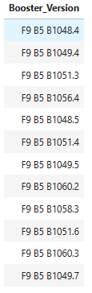
Boosters Carried Maximum Payload
The names of the booster which have carried the maximum payload mass was found with this query:
%sql SELECT Booster_Version FROM SPACEXTBL WHERE PAYLOAD_MASS__KG_ = (SELECT MAX(PAYLOAD_MASS__KG_) FROM SPACEXTBL);
The results are shown to the right

Slide 43
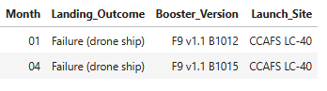
2015 Launch Records
The failed landing_outcomes in drone ship, their booster versions, and launch site names for in year 2015 were found with this query: %sql SELECT substr(Date, 6, 2) AS Month,Landing_Outcome, Booster_Version, Launch_Site FROM SPACEXTBL WHERE substr(Date, 1, 4) = '2015' AND Landing_Outcome = 'Failure (drone ship)';
Result:

Slide 44
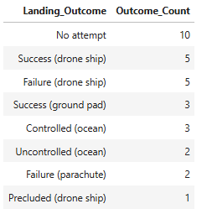
Rank Landing Outcomes Between 2010-06-04 and 2017-03-20
The count of landing outcomes (such as Failure (drone ship) or Success (ground pad)) between the date 2010-06-04 and 2017-03-20, were ranked in descending order using this query: %sql SELECT Landing_Outcome, COUNT(*) AS Outcome_Count FROM SPACEXTBL WHERE Date BETWEEN '2010-06-04' AND '2017-03-20' GROUP BY Landing_Outcome ORDER BY Outcome_Count DESC;
Result shown to the right

Slide 45

Section 3

Slide 46
Folium map sreenshots
Unfortunately, screenshots for the folium map were not obtained.

Slide 47

Section 4

Slide 48
Dashboard Screenshot: Launch Success Count for All Sites
The plot shows that the site with the most successful launches (41.7% of all successful launches) was KSC LC-39A
The site with the fewest successful launches was CCAFS SLC-40

Slide 49
Dashboard Screenshot: Site with Highest Success Ratio
The site with the highest success rate is CCAFS SLC-40, with a success rate of 42.9%

Slide 50
Dashboard Screenshot: Payload vs. Launch Outcome scatter plot for CCAFS SLC-40
The plot shows the payload vs. outcome for CCAFS SLC-40 for the full range of payload masses
Payload range can be selected with the slider
A screenshot of the plot for all sites was not taken

Slide 51

Section 5

Slide 52
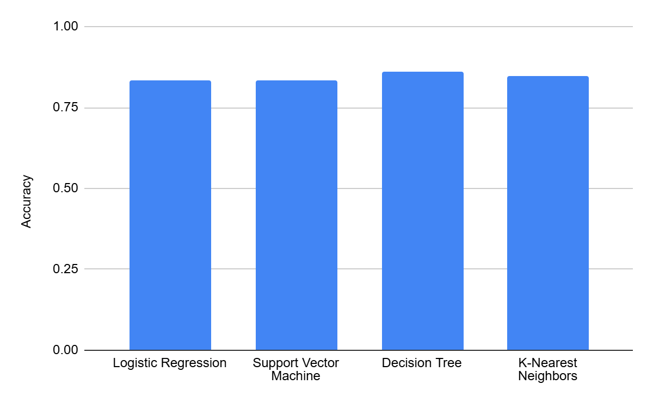
Classification Accuracy
The model accuracy for each tuned model is shown to the right.
The Decision Tree model has the highest accuracy.

Slide 53
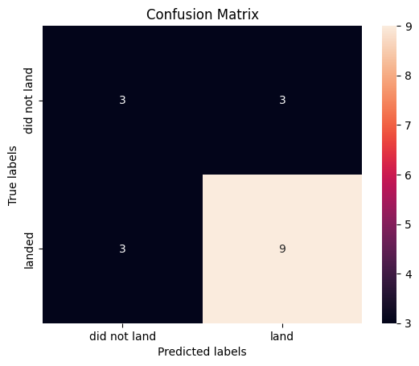
Confusion Matrix
The confusion matrix for the Decision Tree model is shown to the right.
The matrix shows relatively low errors for both Type 1 and Type 2 errors with 3 each.
The model successfully predicts the correct outcome in 12 of the cases for the test set (9 landed and 3 did not land)

Slide 54
Conclusions
The Decision Tree Model performs best for this dataset
Launches with higher payload mass show greater success rates
Most launches are from sites close to the equator and close to the coastline
Success rates have increased over time

Slide 55
Appendix
All relevant code and notebooks can be found here: https://github.com/JCarr412/Coursera-DataScience

Slide 56


